Slide 1

WINE QUALITY PREDICTION USING MACHINE LEARNING
Project Supervisor: Dr.T.JUDGI., M.E,Ph.d
Name of the Student: PASHAM VYSHNAVI
Register Number: 40111456

Slide 2
Presentation Outline
Course Certificate
Introduction
Objectives
System Architecture / Ideation Map
Project Implementation
Results and Discussions
Result Snapshots
Conclusion & Future work
References

Slide 3
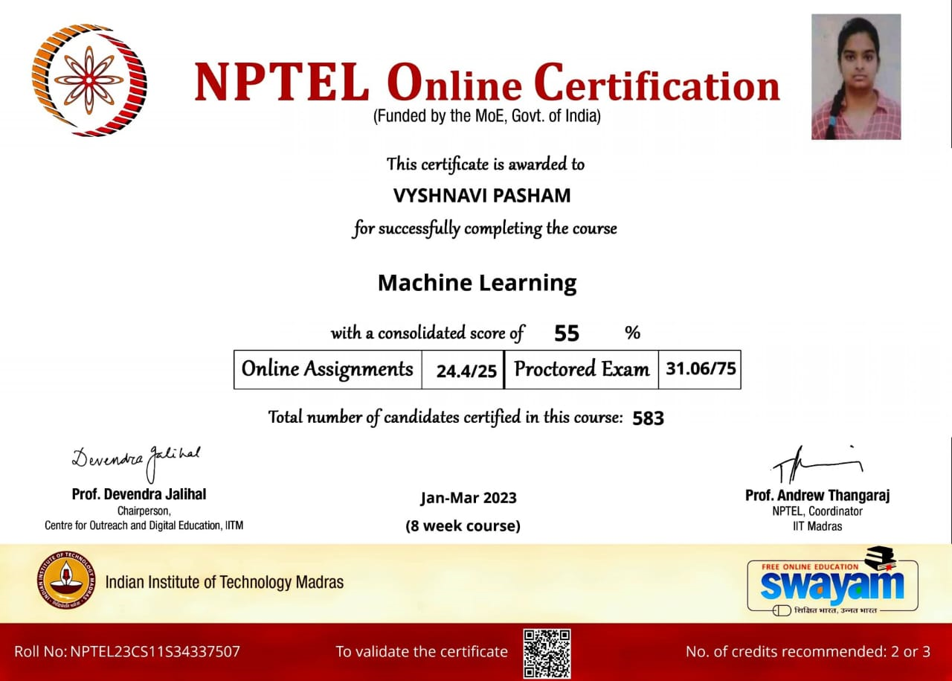
Course Certificate

Slide 4
Introduction
The wine industry shows recent exponential growth as social drinking is on the rise.
Wine is the most commonly used beverage globally, and its values are considered important in society.
Nowadays, industry players are using product quality certifications to promote their products.
This is a time-consuming process and requires the assessment given by human experts, which makes this process very expensive.

Slide 5
Introduction
S.
A vital factor in wine certification and quality assessment is physicochemical tests, which are laboratory-based and consider factors like acidity, pH level, sugar, and other chemical properties.
The wine market would be of interest if the human quality of tasting can be related to wine’s chemical properties so that certification and quality assessment and assurance processes are more controlled.
This project aims to determine the quality of wine production taking factors like acidity, pH level, sugar, and other chemical properties as data.

Slide 6
Problem Statement
The quality of a wine is important for the consumers as well as the wine industry. The traditional (expert) way of measuring wine quality is time-consuming. Nowadays, machine learning models are important tools to replace human tasks.
Therefore, The goal of this project is to use Machine Learning to Predict the Quality of Wine taking various factors like acidity, pH level, sugar, and other chemical properties as the input data.

Slide 7
Objectives
Objectives of this project are:
To Predict the Quality of Wine Produced
This project aims to determine which features are the best quality red wine indicators and generate insights into each of these factors to our model’s wine quality.
The Objective of this project is to develop a system that can perform early prediction of the quality of wine with higher accuracy by machine learning techniques and models. To achieve this goal, we used a Linear regression model

Slide 8
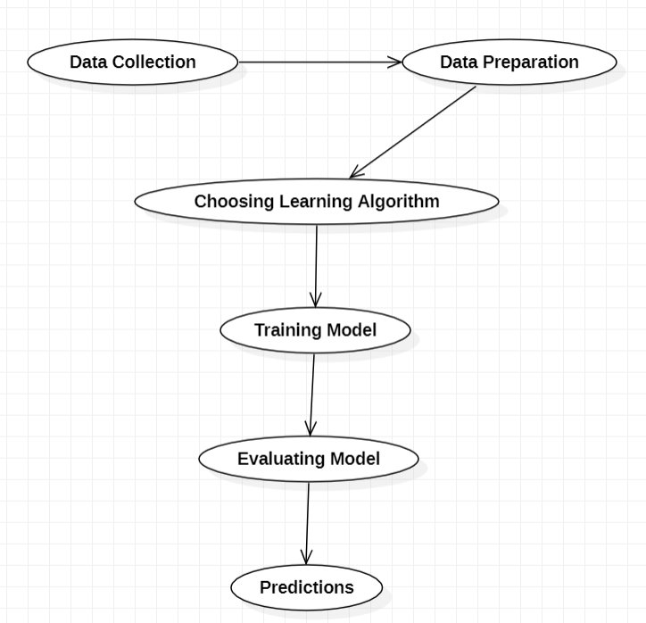
System Architecture / Ideation Map

Slide 9
Project Implementation
To implement this project we need to follow the below steps
GetData :
Gather all the features for the quality prediction.
DataCleaning :
Check for Null values and replace them with mean value of the column.
DataPreprocessing :
Divide the data into features(x) and label(y).
Train and Test:
Split the dataset into train(80%) and test(20%).
Model Selection :
Implement Linear regression for the given data set.
Model Evaluation :
Check Regression Metrics.

Slide 10
Project Implementation
Modules :
Import libraries
Reading and studying data
Visualization
Correlation matrix
Stereotype
Hardware/Software requirements :
4GB RAM, Operating System, Windows 10, Intel i5 processor Generation, Anaconda, Python 3.8.

Slide 11
Result and Discussions
Confusion matrix and its related metrics were given a good score, So by this, we can conclude that our model performed well.
Hence, we can say that our model is pretty good because by implementing all the steps above mentioned we calculated MAE, MSE, and RMSE it is a pretty good model and our predictions will be effective.

Slide 12
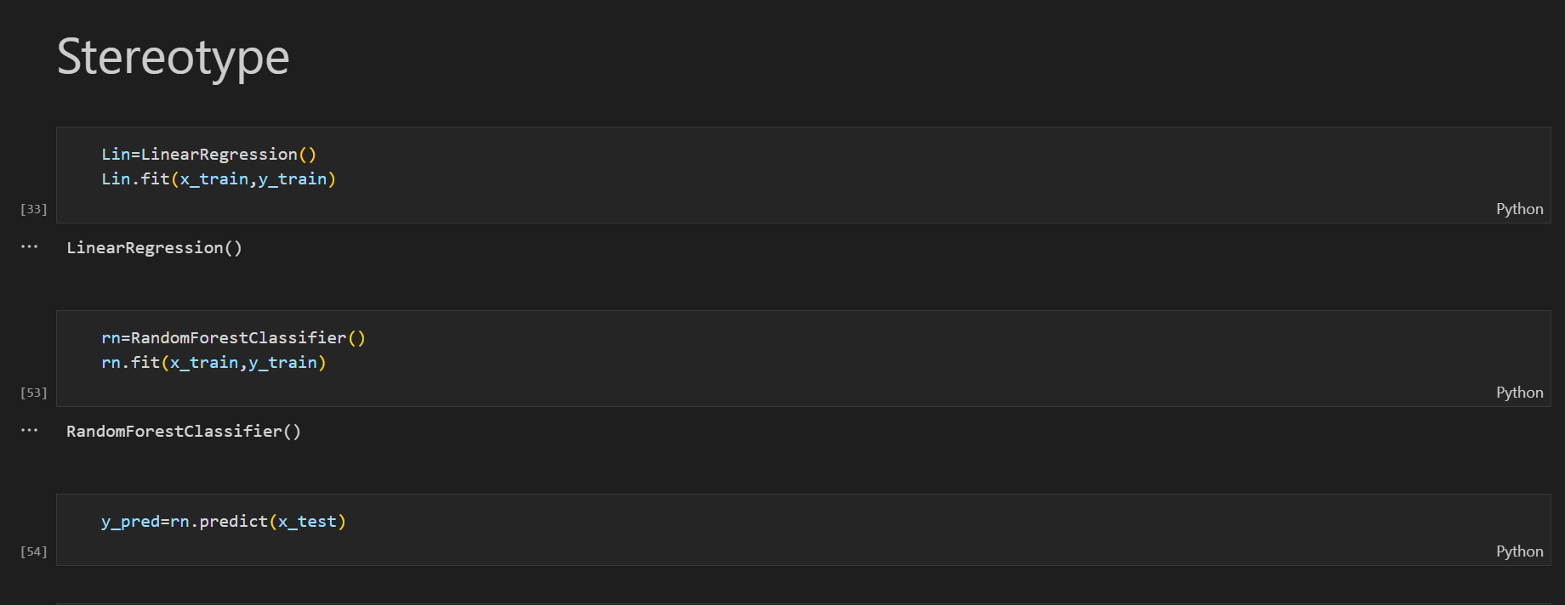

Slide 13
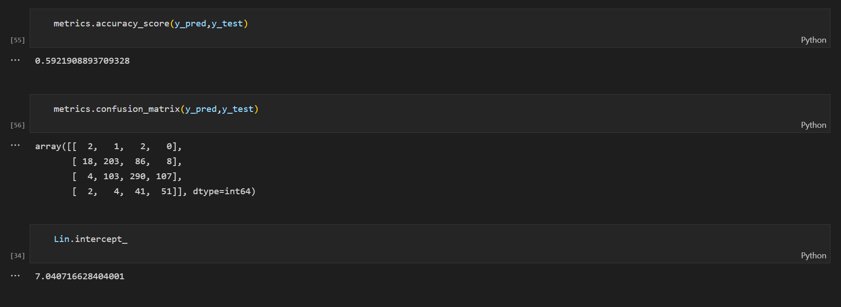
Result snapshots

Slide 14
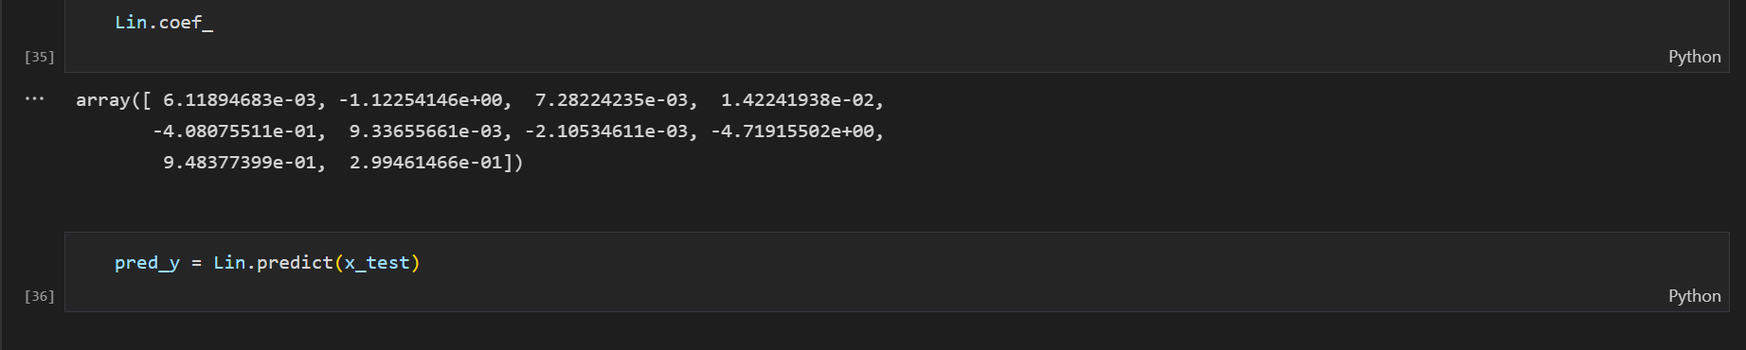

Slide 15
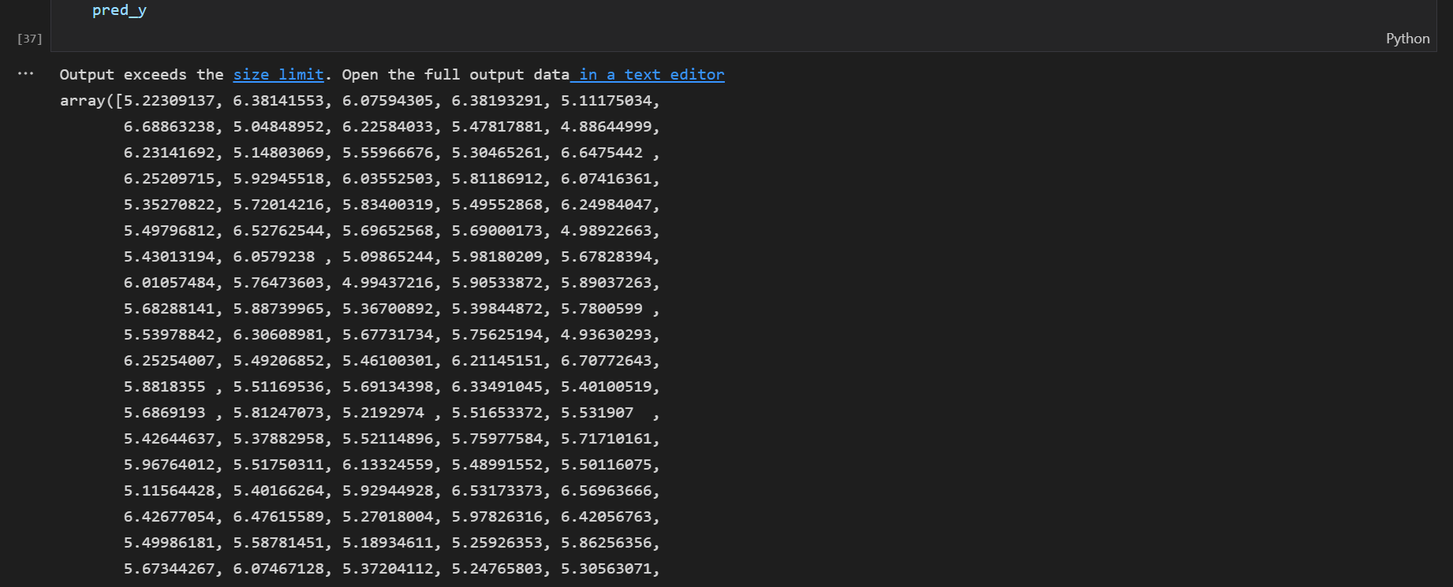

Slide 16
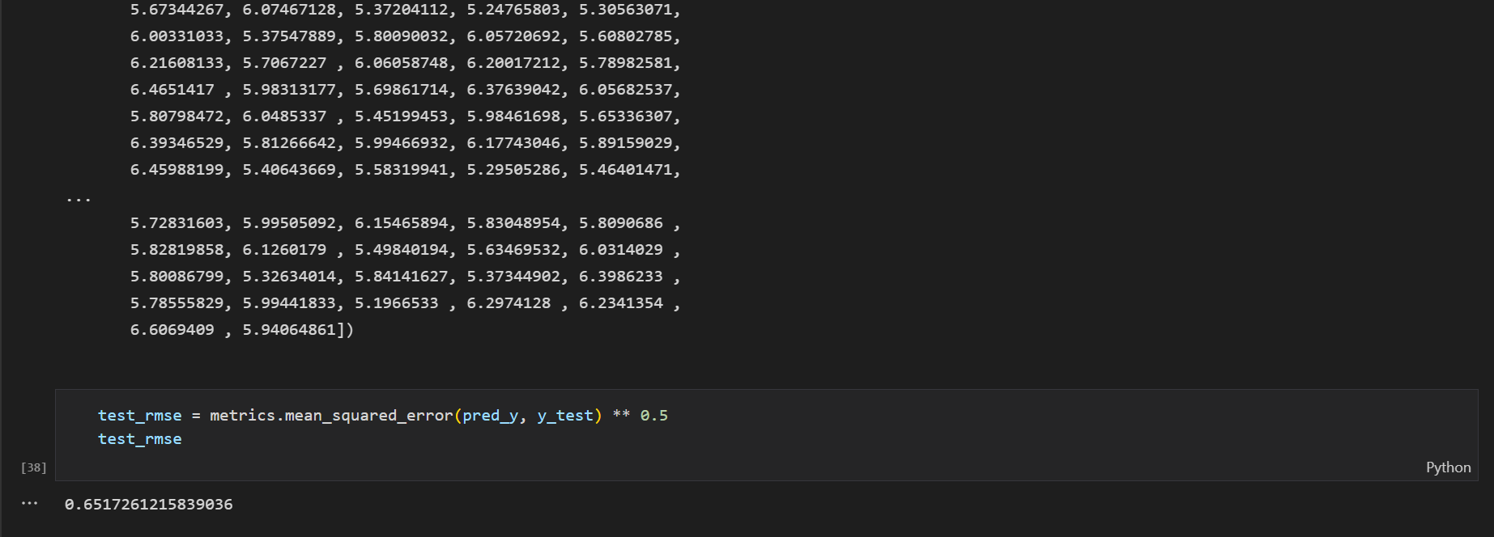

Slide 17
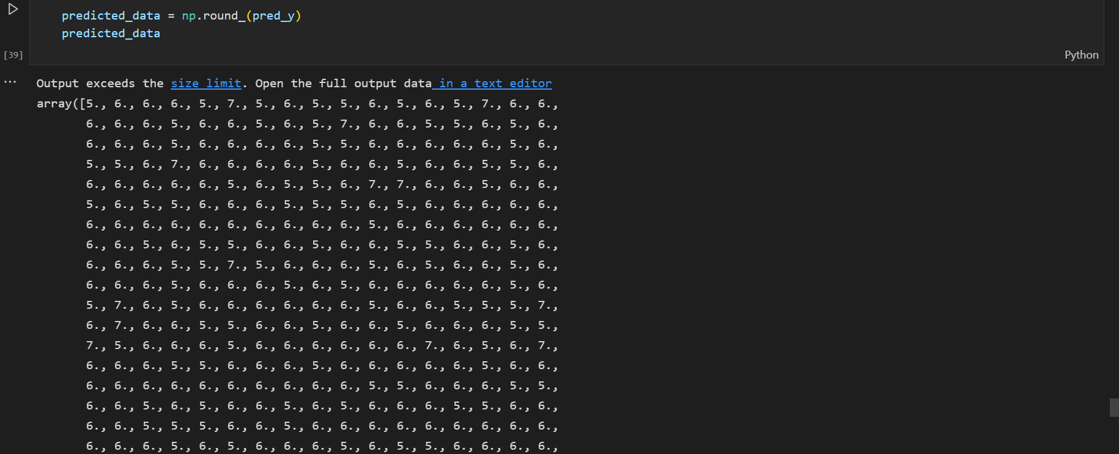

Slide 18
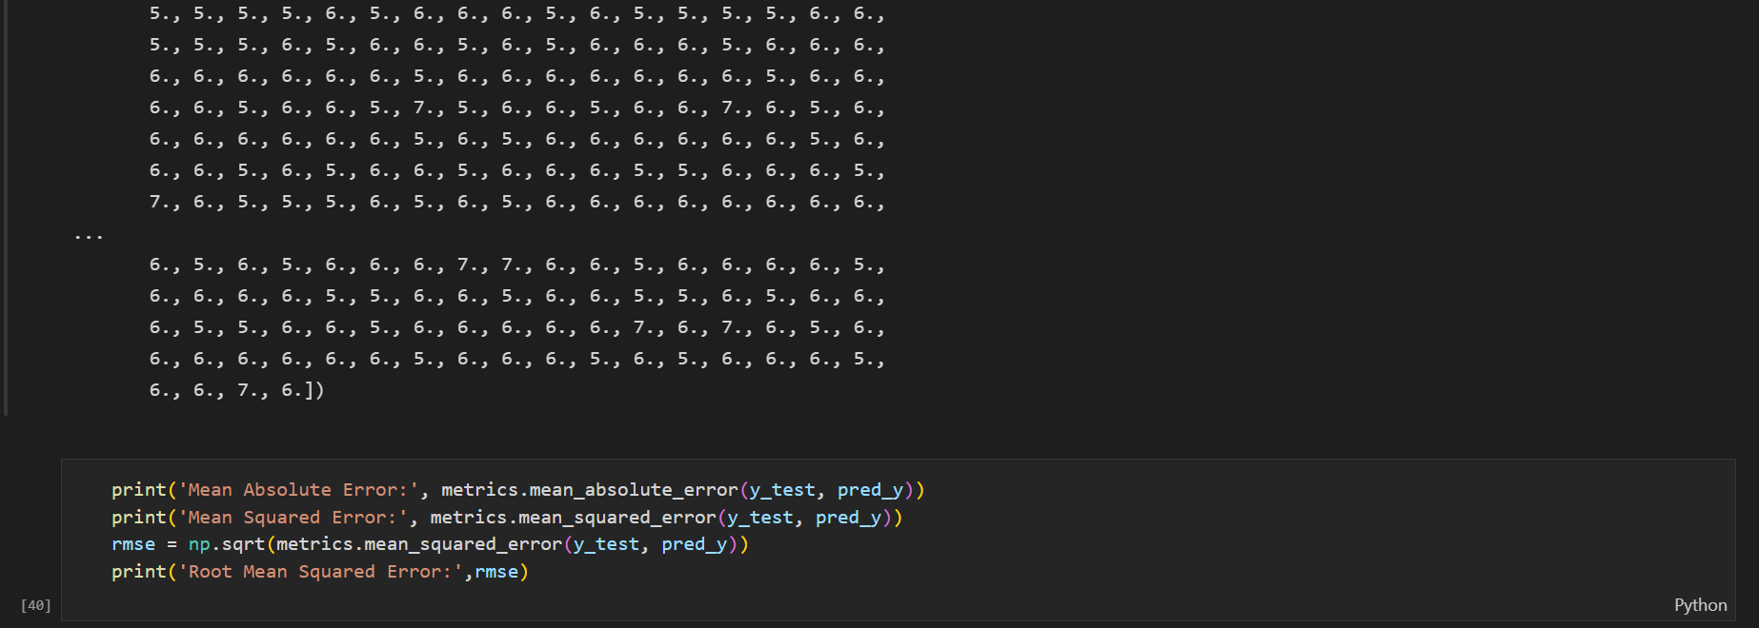

Slide 19
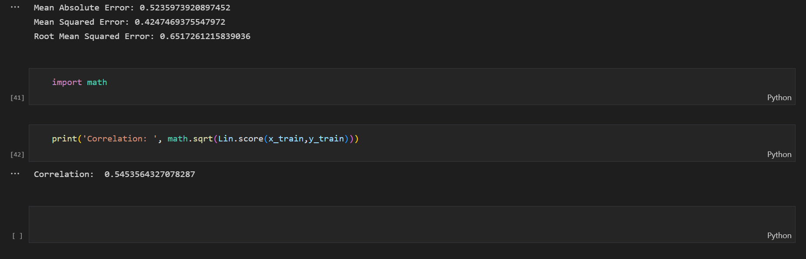

Slide 20
Conclusion and Future Work
Machine learning approaches work well for wine prediction. Prediction of wine quality helps a lot for the government to ban low-quality or cheap wines which are unhealthy for people.
-> I had taken a wide range of research about different ML Algorithms and finally choose a Linear regression approach to solve this problem.
-> In this project, we implement a Linear regression approach and we observed that it predicted very well.
-> In the process of research, I came to know about the various ML techniques and their different algorithms which help to solve real-world problems.

Slide 21
References
For Learning Python Language:- https://www.leampython.org/
GitHub:-https://github.com/dabeaz-course/practical-python/blob/master/Notes/Contents.md
Numpy:- https://numpy.org/doc/stable/user/quickstart.html
To conduct this project the following tools have been used :
Pandas (Library) : http://pandas.pydata.org/
Numpy (Library) : http://www.numpy.org/
Scikit­learn (Library) : http://scikit­learn.org/

Slide 22
THANK YOU

